Slide 1



Colloquium
ANMOL, AGARWAL
TITLE
EXAMINING TEMPORAL ISSUES IN EEG-BASED BCI:
DETECTING IMAGINED WORDS IN CONTINUOUS EEG SIGNALS
Berlin and 23.05.2025

Slide 2

Content List
Introduction
1
Literature Review
2
Methodology
3
Research Findings
4
Conclusion
5

Slide 3
01
CHAPTER 1
INTRODUCTION

Slide 4
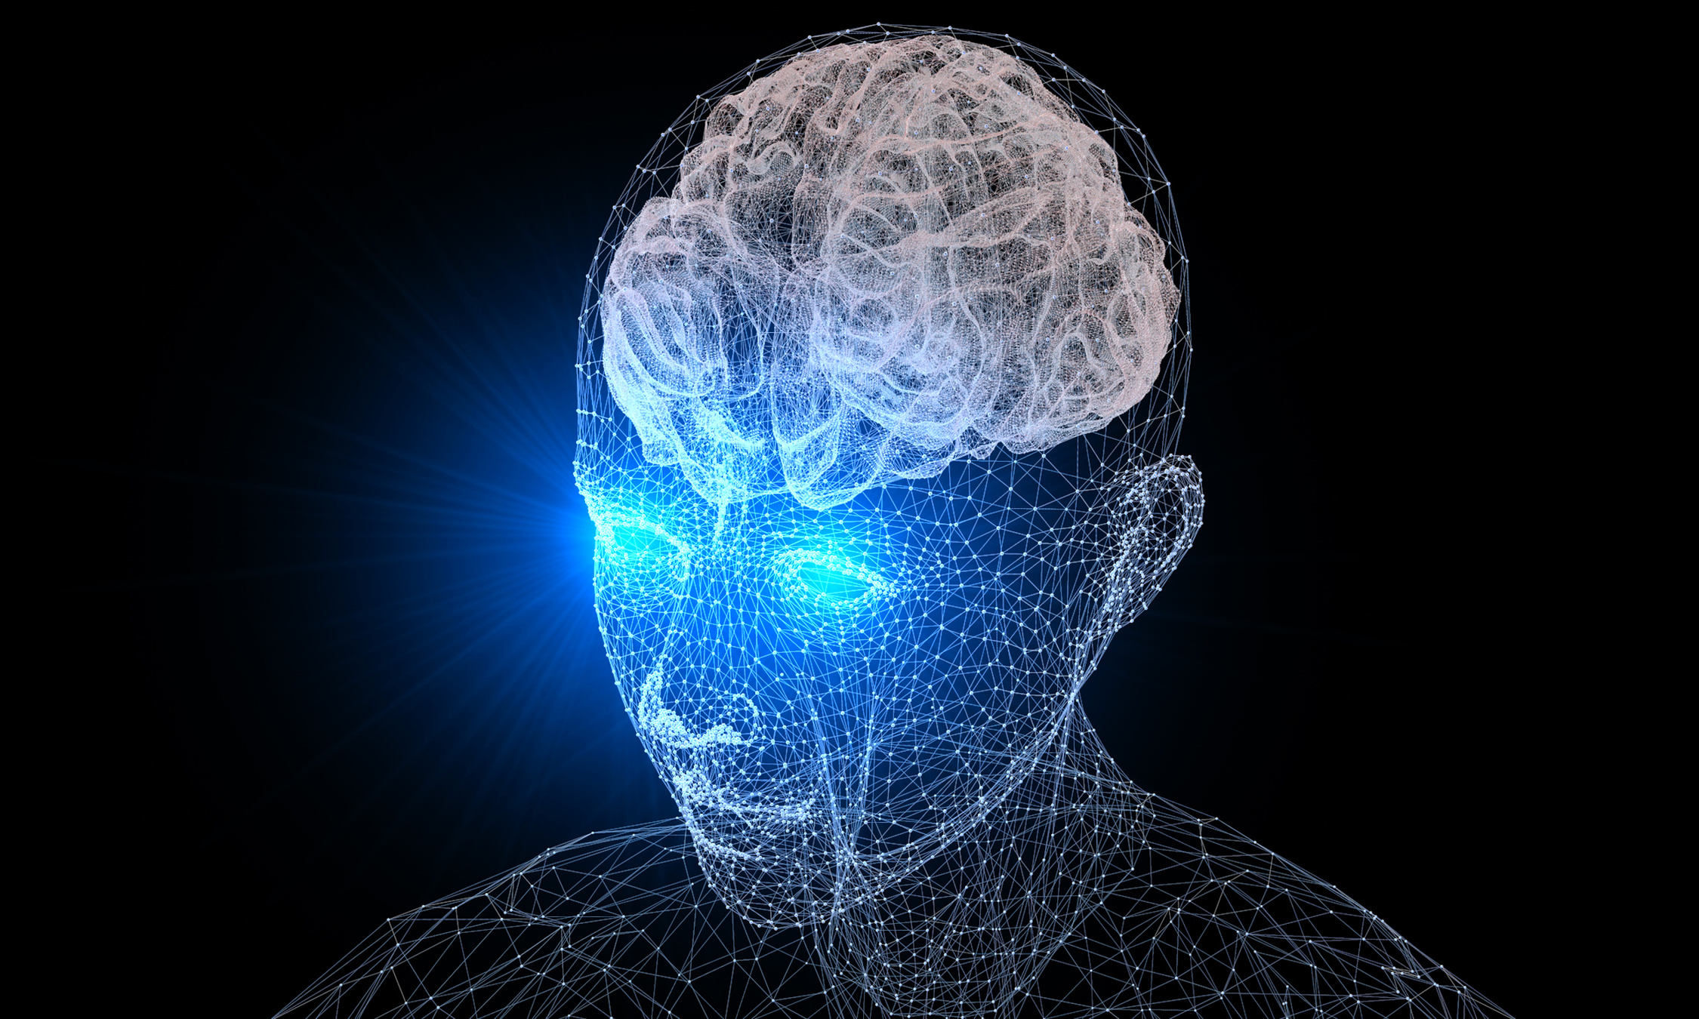
Introduction
Close your eyes and imagine speaking a word.
Imagine being able to communicate simply by thinking. This is the promise of Brain-Computer Interfaces, or BCIs.
Brain-Computer Interfaces (BCIs) offer a way to translate brain signals into commands for external devices, opening up new possibilities for communication and control.
This research explores the exciting possibility of decoding imagined speech directly from brain activity, with the aim of improving communication for people with severe motor disabilities.
Core Problem: This thesis focuses on a specific type of BCI called imagined speech BCI, which aims to decode words that people imagine saying. This technology has the potential to significantly improve the lives of individuals with severe motor disabilities who have lost the ability to speak.

Slide 5
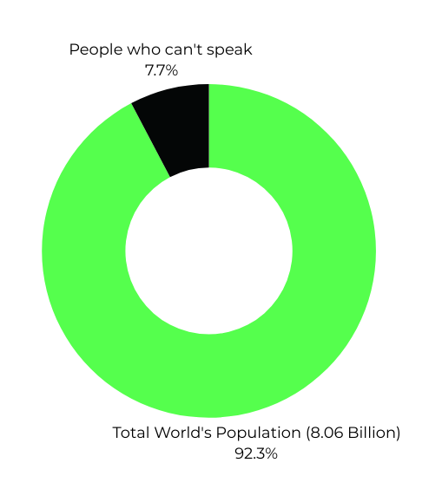
WHY THIS TOPIC?
Due to current limitations in imagined speech recognition accuracy and real-time feasibility.
620.77 Million
People Who Cannot Speak
& Approximately 362,790 individuals are estimated to have ALS as a contributing factor to their inability to speak
My Motivation: The idea that we could control devices or communicate purely through thought felt like science fiction turning into reality and that inspired me to pursue this research. This question wasn’t just academic for me. I’ve always been fascinated by the complexity of the human brain and the possibility that telepathy might one day become real.
Why It Matters:
The potential impact of this technology is on people with severe motor disabilities who are trapped within their own bodies, unable to communicate their thoughts and needs. I saw an opportunity to make a real difference in their lives by enabling them to communicate through thought alone​.

Slide 6




Real-World Applications & Importance
Assistive Communication :
Imagined speech BCI could let paralyzed or mute individuals “speak” through a computer by just thinking words​. This has life-changing implications for patient autonomy and quality of life.
Hands-Free Control:
BCIs are being explored to control wheelchairs, prosthetics, or smart home devices by thought​. An imagined speech interface can complement these, allowing complex commands (words/sentences) instead of simple motor imagery.
Healthcare & Rehabilitation:
Such systems can aid stroke or neurodegenerative diseases like ALS highlights the urgent need for innovative communication solutions. It also contributes to neurofeedback therapies – e.g. patients training to produce certain brain patterns.
Brain-Computer Communication:
In the long term, this research is a step toward seamless brain-computer communication. Changing TV channels, sending messages, or creative expression (painting, writing) could all be done via thought commands​​. The importance is clear: it expands how humans interact with technology.
Current problems with EEG

Slide 7

Current Problems
with EEG based BCI
Electroencephalography (EEG) is a non-invasive technique that measures the electrical activity of neurons in the neocortex.
Decoding imagined speech from EEG signals is like trying to decipher a secret code.
EEG-based brain-computer interfaces (BCIs) systems often struggle with low accuracy and reliability, hindering their practical application. Some of the key issues include:
1. The brain's electrical signals are incredibly noisy and complex, artifacts overlap makes it difficult to extract meaningful patterns.
External interference from environmental electrical sources.
2. High Inter-Subject Variability
Brain activity patterns differ significantly across individuals, necessitating personalized calibration for each user, which increases the complexity of real-world applications.
3. Temporal and Spatial Complexity of Imagined Speech
EEG signals evolve over time, making it challenging to detect the precise moment when a person starts imagining a word.
Existing feature extraction methods struggle with identifying distinct patterns for different words due to overlapping neural activity.
4. High Dimensionality and Computational Challenges
EEG data are high-dimensional.
Processing such large datasets in real-time increases the risk of overfitting machine learning models, leading to poor generalization.
Computational efficiency is a major concern, as real-time BCIs require low-latency processing to ensure a seamless user experience.

Slide 8


RESEARCH OBJECTIVES
My research aimed to tackle these challenges by developing and evaluating three sophisticated EEG classification models, assessing various feature extraction methods, and investigating PCA's effectiveness for dimensionality reduction.
GOAL 1: Which deep learning architecture (Transformer, CNN-LSTM, or Vanilla Multi-Layer Perceptron) is most effective for EEG classification?
GOAL 2: How do different feature extraction methods (Fast Fourier Transform, Mean Phase Coherence MPC, Magnitude Squared Coherence (MSC)) impact the performance of these models?
GOAL 3: Does PCA-based dimensionality reduction improve model generalization?
MLP
CNN_LTSM
Deep Learning
Models
FFT
Feature
Extraction Methods
Transformer
MPC
MSC

Slide 9
02
CHAPTER 2
LITERATURE REVIEW

Slide 10
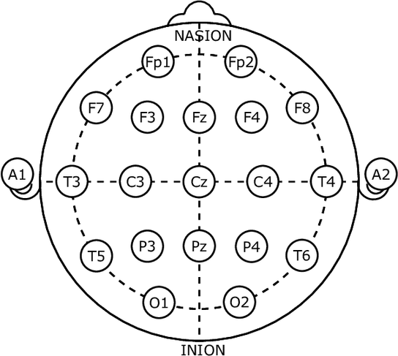
Overcoming Limitations
in EEG - based BCI
Several gaps and limitations were identified in the current research. Many studies focused on traditional machine learning models, which may not be optimal for capturing the complex patterns in EEG data. Additionally, many studies rely on FFT (frequency-based features) but overlook connectivity-based insights such as MPC and MSC. Handling high-dimensional EEG data remains a challenge, with limited research on PCA for dimensionality reduction in deep learning.
To address these gaps
We proposed a Transformer-based deep learning model, which is particularly well-suited for capturing long-range dependencies in EEG sequence data. LSTM was used for comparison, extracting both spatial and temporal EEG features, while MLP served as a baseline for performance evaluation.
To enhance model performance, PCA is used to reduce the high-dimensional EEG feature space, improving generalization while preserving essential information for classification.
Most of the standard EEG devices available are arranged consistently using the global 10-20 system.
This figure shows the view from the top of the head with the nose at the front.
Notes:
Before diving into our methodology, it's important to acknowledge the existing body of research that laid the foundation for our work. We reviewed numerous studies on EEG-based BCI, exploring various feature extraction and classification techniques.

Slide 11
Why these methods?
Raw EEG data contains irrelevant, redundant, and noisy signals. Feature extraction transforms this into meaningful representations for classification. The major feature types are:
Frequency-Based Features:
Fast Fourier Transform (FFT): Converts EEG signals from the time domain to the frequency domain to extract power spectral features.
Extracted frequency bands: Delta (0.5–4 Hz), Theta (4–8 Hz), Alpha (8–12 Hz), Beta (12–30 Hz), and Gamma (30–50 Hz).
Connectivity-Based Features:
Mean Phase Coherence (MPC): Measures how well two EEG signals remain in phase over time . The MPC method stands apart from regular amplitude-based correlation techniques as it specifically detects brain activity synchronization patterns, since different words correspond to distinct brain wave patterns, which are essential for understanding EEG-based BCI functional connectivity.
Magnitude Squared Coherence (MSC): Measures the power correlation between two signals in the frequency domain. It quantifies the linear relationships between EEG signals across specific frequency bands by analyzing both their amplitude and phase connections. Unlike Mean Phase Coherence (MPC), MSC offers a more comprehensive assessment of neural synchronization by combining power correlation analysis with phase stability evaluation.
PCA: Helps in removing redundant and noisy features, enhancing model generalization across subjects.

Slide 12
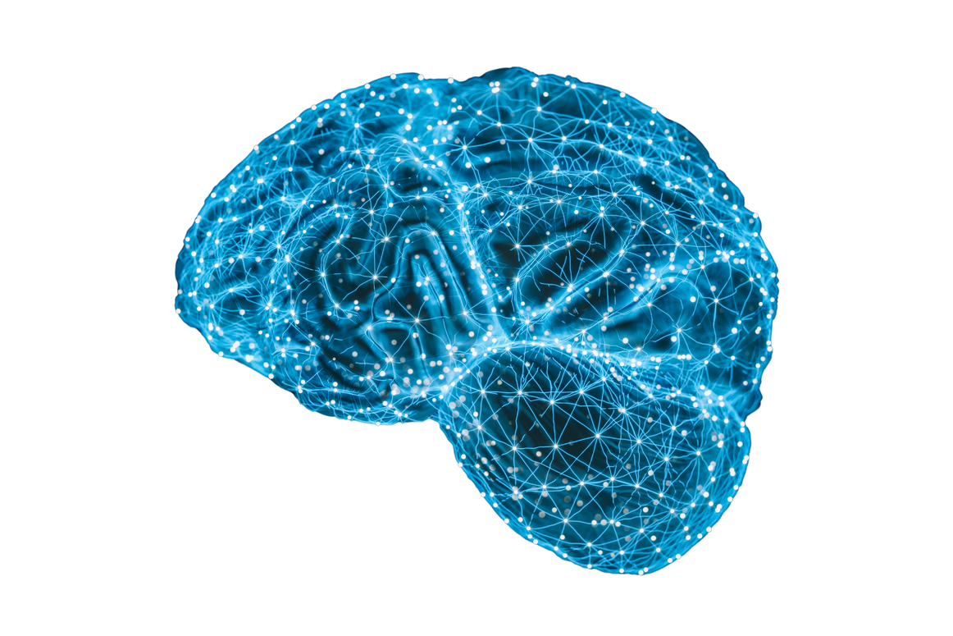
Why these models?
Transformer
EEG signals have complex temporal patterns that require long-range dependency modeling.
The self-attention mechanism in Transformers efficiently captures global relationships across EEG time sequences.
Unlike CNN-LSTM, Transformers process sequences in parallel, improving computational efficiency.
Achieves higher accuracy in EEG-based imagined speech classification compared to traditional deep learning models.
CNN-LSTM: Extracting Spatial and Temporal Features
EEG signals contain both spatial and temporal (signal variation over time) features.
CNN layers extract spatial patterns, while LSTM layers model temporal dependencies in EEG sequences.
Well-suited for tasks requiring localized feature extraction and short-term dependencies.
Multi Layer Perceptron: Baseline for Performance Evaluation
Serves as a benchmark for performance comparison.
MLPs process EEG data as flattened feature vectors, which limits their ability to capture sequential patterns.
Helps in evaluating how much deep learning architectures (CNN-LSTM, Transformer) improve EEG classification compared to a simpler neural network.

Slide 13
03
CHAPTER 3
METHODOLOGY

Slide 14
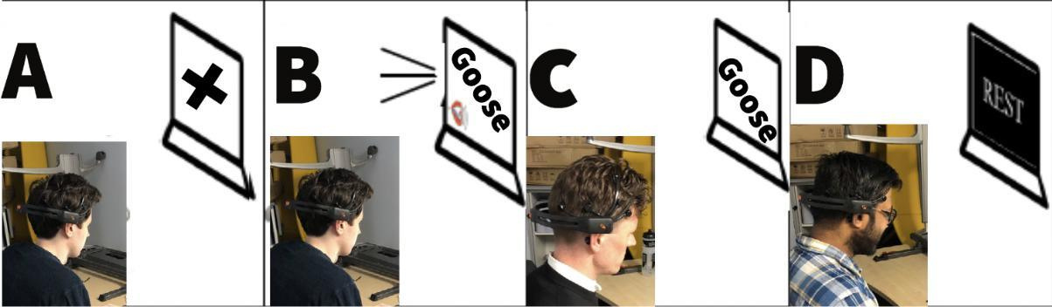
Data Acquisition
We used a publicly available EEG dataset containing imagined speech trials from multiple subjects. The dataset was collected using the Emotiv EPOC+ headset, a non-invasive EEG device with 14 electrodes and a sampling frequency of 256 Hz.
Dataset Overview:
20 unique words mapped to labels.
50 trials per word across multiple subjects.
1,000 trials before augmentation.
Experimental Procedure:
1️⃣ Rest State: Participants focused on a displayed cross during the rest period.
2️⃣ Word Presentation: A word was presented visually on the screen.
3️⃣ Imagination Phase: Participants mentally visualized the word while keeping their vocal cords and muscles stationary.
4️⃣ Rest State: After imagining the word, participants returned to a resting state.
*During the experiment, subjects were instructed to imagine the displayed words. The EEG signals were recorded and preprocessed for further analysis.
[A] The cross indicates that the participant must focus intently on the screen. [B] Word is presented.
[C] Participant imagines the word. [D] Participant after imagination is in the rest/idle state.

Slide 15
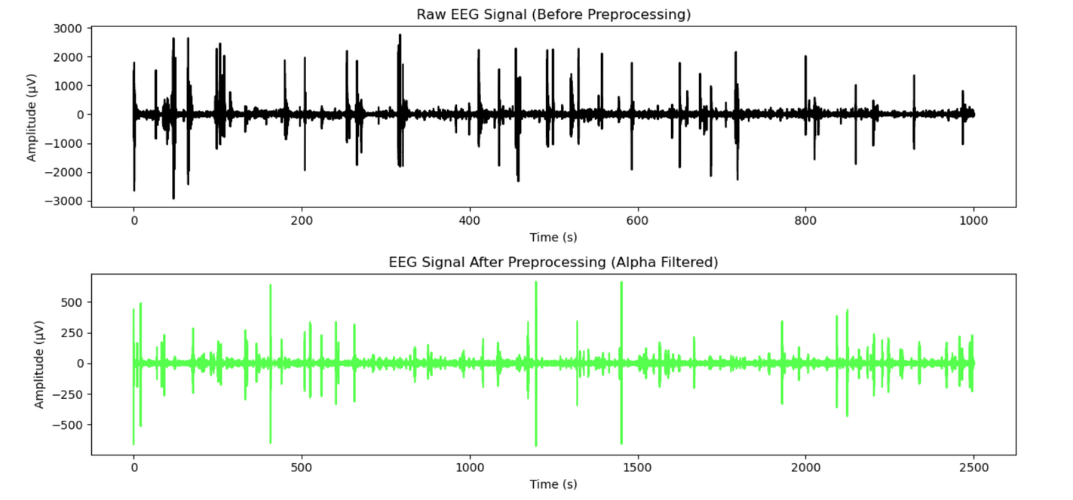
Preprocessing & Signal Cleaning
EEG data is highly susceptible to noise and artifacts from eye movements, muscle contractions, and external interferences. Preprocessing maximize high signal-to-noise ratio (SNR), making it possible to decode imagined speech accurately.
Preprocessing Steps:
✔ Bandpass Filtering (1–50 Hz) – Removes high-frequency noise, preserving meaningful EEG signals.
✔ Notch Filtering (50/60 Hz) – Eliminates power line interference (50 Hz for EU, 60 Hz for US).
✔ Artifact Removal (ICA - Independent Component Analysis) – Detects and removes artifacts from eye blinks and muscle activity.
✔ Epoching – Segments continuous EEG data into 1-second epochs (256 samples per epoch) for structured analysis.
✔ Data Augmentation (Sliding Window) – Expands the dataset from 1,000 to 5,000 trials using a 128-sample window with a 32-sample overlap, improving model generalization.
Raw Data: At 256 Hz, i.e. 256,000 / 256 ≈ 1,000 seconds of data.
Pre-processed Data:
Augmentation → 5000 trials × 128 samples each = 640,000 total samples.
At 256 Hz, i.e 640,000 / 256 ≈ 2,500 seconds—data

Slide 16
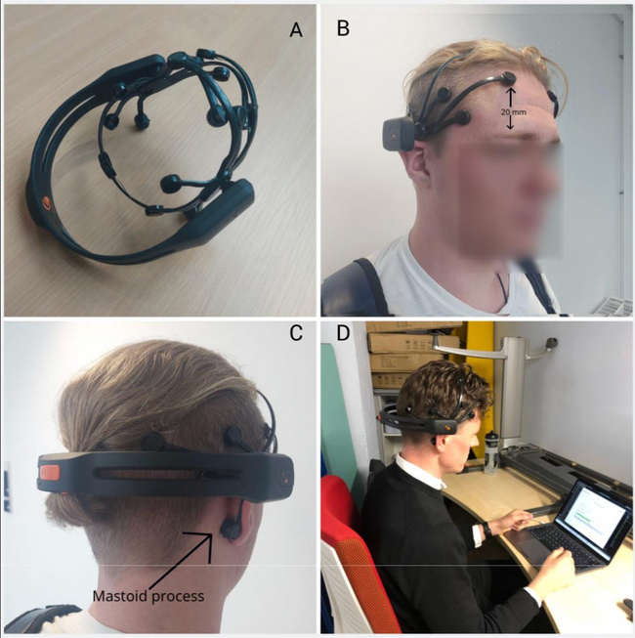
Feature Extraction
1️⃣ Frequency-Based Features (FFT)
Fast Fourier Transform (FFT) converts EEG signals from time domain to frequency domain to extract spectral features.
Extracted EEG frequency bands:
Delta (0.5–4 Hz) – Deep relaxation & sleep
Theta (4–8 Hz) – Cognitive workload
Alpha (8–12 Hz) – Attention & focused mental state
Beta (12–30 Hz) – Active thinking
Gamma (30–50 Hz) – Higher cognitive functions
2️⃣ Connectivity-Based Features
Mean Phase Coherence (MPC): Measures phase synchronization between EEG channels, improving classifier robustness by filtering out noise and mapping functional connectivity in speech-related brain regions.
Magnitude Squared Coherence (MSC): Captures both amplitude and phase relationships, enhancing neural interaction detection while reducing false correlations.
3️⃣ Dimensionality Reduction (PCA)
Reduced feature space from 546 to 110 features while retaining 95% variance.
Benefits: Minimizes overfitting, improves computational efficiency, and enhances classification performance.
[A] Emotiv EPOC+ device used for EEG recording. [B] F3/F4 sensors placed 20mm above eyebrows for consistency. [C] M1/M2 dummy electrodes positioned on the mastoid process. [D] Participant in a hemi-anechoic environment, seated in isolation.

Slide 17
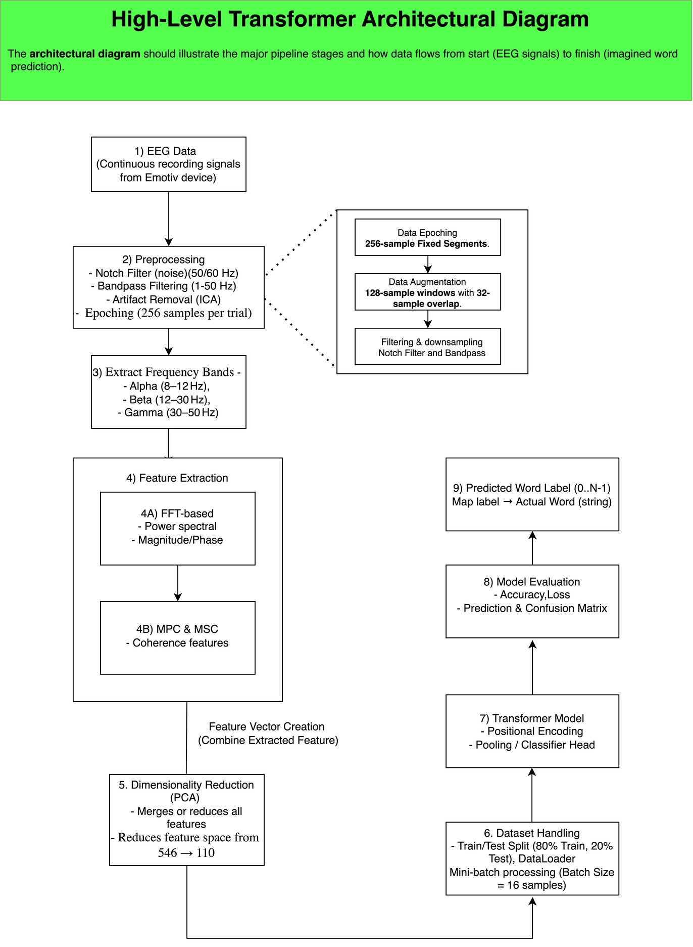
Deep Learning Models
1️⃣ Multi-Layer Perceptron (MLP) - Baseline Model
Input: Flattened EEG feature vectors.
Architecture: Fully connected layers and dropout for regularization.
Purpose: Serves as a benchmark to compare against more advanced models.
2️⃣ CNN-LSTM Hybrid Model (Spatial + Temporal Feature Extraction)
Input: EEG signals reshaped into 2D images (channels × time).
Architecture:CNN Layers: Extract spatial EEG features.
LSTM Layers: Capture temporal dependencies in EEG signals.
Regularization: Dropout & batch normalization to prevent overfitting.
Purpose: Leverages CNN for spatial and LSTM for sequential patterns in EEG data.
3️⃣ Transformer Model
Input: EEG data transformed into sequences (batch_size, seq_len, input_dim).
Architecture: Positional Encoding: Retains sequential order of EEG signals.
Transformer Encoder: Multi-head self-attention layers capture long-range dependencies.
Classifier: Fully connected layer for word classification.
Purpose: Most advanced model, effectively learns global dependencies in EEG data.

Slide 18
04
CHAPTER 4
RESEARCH FINDINGS

Slide 19
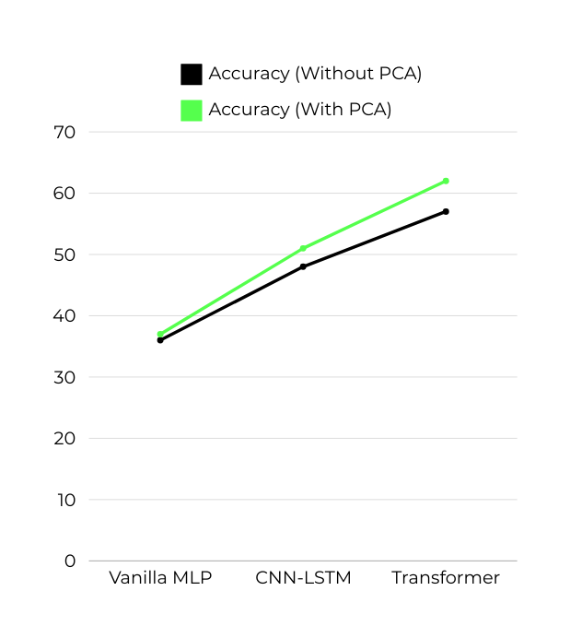
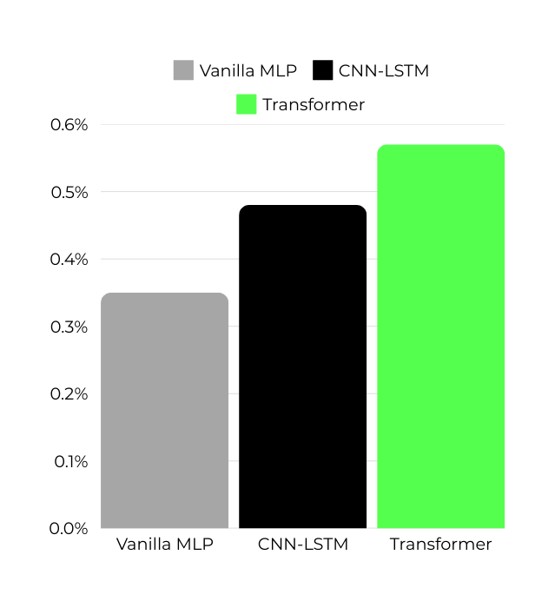
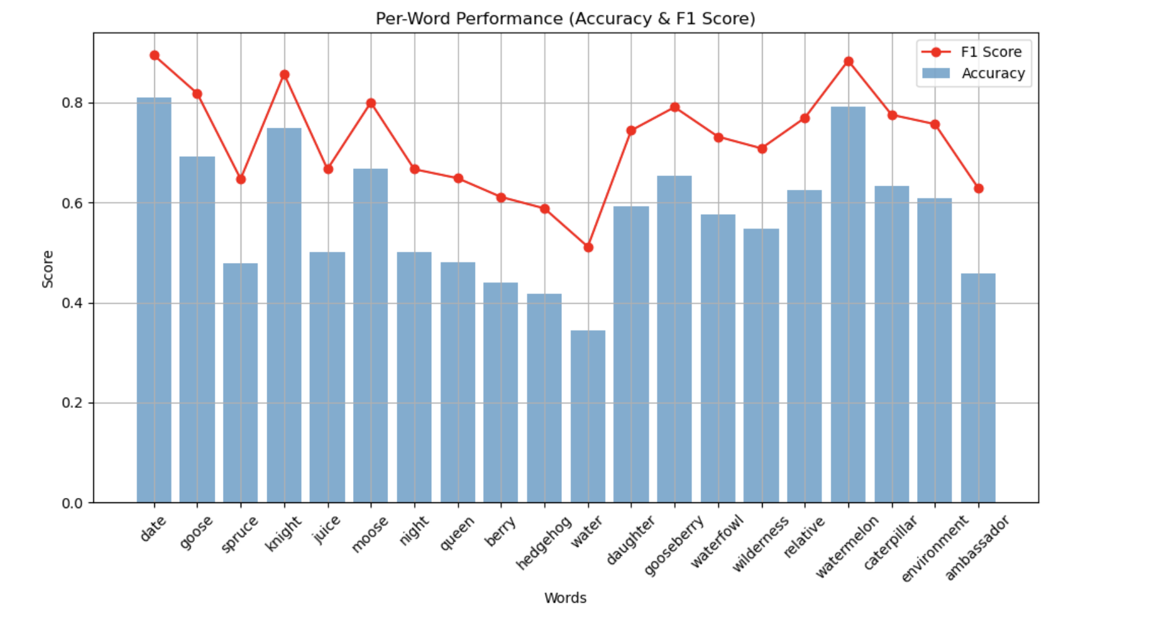
Model Performance
& Comparative Results
As you can see from this graph, the Transformer-based model outperformed the other models, achieving the highest accuracy and F1-score.
Transformer achieved the highest accuracy (62.4%) and F1-score (0.61) after PCA.
CNN-LSTM outperformed MLP, demonstrating the benefit of combining spatial and temporal feature extraction.
PCA improved accuracy and F1-score across all models, reducing dimensionality and improving generalization.

Slide 20
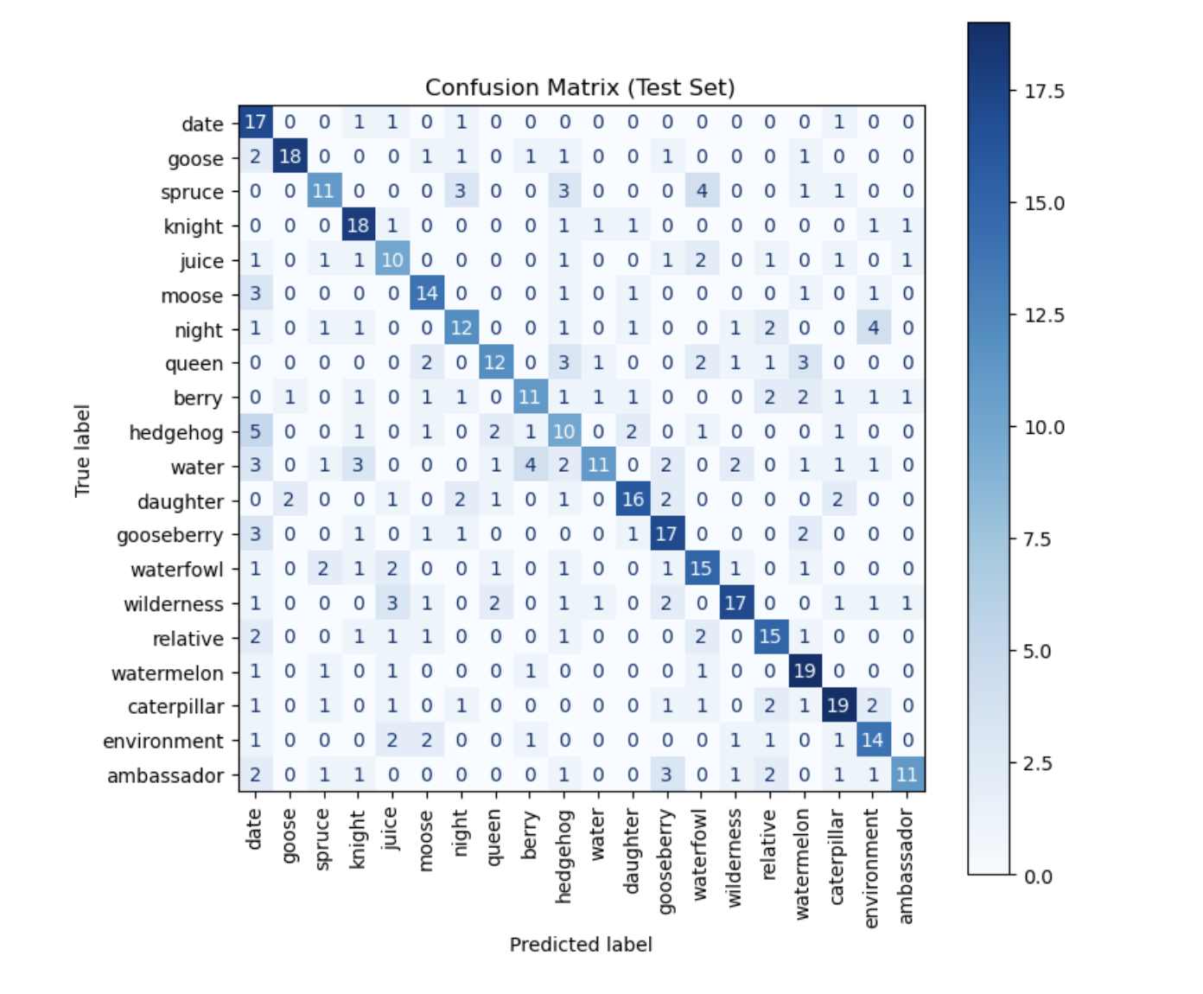
Key Observations
✅ Transformer Model Performed Best
Highest accuracy (62.4%) and F1-score, capturing long-range dependencies in EEG sequences.
Self-attention mechanism improved imagined speech recognition.
Performed well across alpha, beta, and gamma bands but showed minor confusion with phonetic overlaps (e.g., “spruce” vs. “night”).
✅ PCA Enhanced Model Performance
Reduced features (546 → 110), improving training efficiency & generalization.
Prevented overfitting, maintaining 95% variance (Mousavi et al., 2024).
✅ CNN-LSTM Improved Over MLP
50.8% accuracy (vs. MLP: 37.2%) by combining spatial & temporal feature extraction.
Less effective than Transformer at handling long-range dependencies.
✅ Feature Extraction Boosted Accuracy
FFT: Extracted EEG frequency features for mental state classification.
MPC & MSC: Improved accuracy by capturing EEG connectivity patterns.
Summary
✔ Transformer > CNN-LSTM > MLP, excelling at EEG-based imagined speech recognition.
✔ PCA improved model efficiency & accuracy.
✔ Feature extraction (FFT, MPC, MSC) enhanced classification performance.

Slide 21
05
CHAPTER 5
CONCLUSION

Slide 22
Applications & Implications
✅ Real-World Applications
Real-time BCI for communication: Enables severely disabled patients (ALS, locked-in syndrome) to communicate using EEG-based systems.
Enhanced human-computer interaction: Enables control of smart devices, VR navigation, and AI systems using mental commands.
Personalized BCI systems: Adapts to individual EEG patterns, improving accuracy and efficiency.
Healthcare & rehabilitation: Supports patient independence and enhances quality of life (Contreras-Vidal et al., 2023).
✅ Research Implications
Deep Learning for EEG:Transformer models excel in imagined speech classification, outperforming traditional models.
MPC & MSC enhance EEG connectivity analysis, improving recognition accuracy.
Dimensionality Reduction (PCA):Reduces feature complexity, prevents overfitting, and improves training efficiency.
Maintains high accuracy while optimizing computational resources.

Slide 23
Limitations & Future Work
🔹 Limitations
Limited dataset size – Affects generalization; a more diverse dataset is needed.
Subject-specific EEG variations – Brainwave patterns differ across individuals, impacting model consistency.
Real-time execution challenges – Computational constraints and latency hinder deployment on portable devices.
Feature extraction improvements – While MPC & MSC captured connectivity, alternative techniques like DWT could further enhance accuracy.
🔹 Future Work
Data Augmentation (GANs): Generate synthetic EEG trials to improve model robustness.
Transfer Learning: Adapt models across subjects to minimize user-specific training.
Real-Time Optimization: Develop low-latency EEG classification for portable applications.
Multimodal BCIs: Integrate EEG with EMG or eye-tracking for improved accuracy.
Healthcare Applications: Enhance BCI-based communication for patients with severe motor disabilities.
Cross-Domain Use: Extend findings to emotion detection, cognitive load monitoring, and mental state assessment.

Slide 24
Conclusion
✅ Transformer-based models outperform traditional methods (CNN-LSTM, MLP) in EEG-based imagined speech recognition.
✅ PCA enhances model efficiency and accuracy, reducing overfitting while maintaining key features.
✅ Feature extraction techniques (MPC, MSC, FFT) are crucial for improving classification performance.
✅ Opens new opportunities in healthcare and human-computer interaction, enabling better communication for motor-impaired individuals.
🔹 Key Takeaways:
Self-attention in Transformers captures long-range dependencies, improving recognition accuracy.
PCA and feature extraction ensure better generalization and prevent overfitting.
Challenges remain in real-time execution, dataset size, and personalized models.
🔹 Future Directions:
Data augmentation & transfer learning to enhance model generalization.
Optimizing models for real-time applications to make EEG-based BCIs more practical and accessible.

Slide 25
References
Angelakis, D., Ventouras, E. C., Kostopoulos, S., & Asvestas, P. (2024). Comparative analysis of deep learning models for optimal EEG-based real-time servo motor control. Eng, 5(3), 1708–1736. https://doi.org/10.3390/eng5030090
Ramzan, M., & Dawn, S. (2023). Fused CNN-LSTM deep learning emotion recognition model using EEG signals. International Journal of Neuroscience, 133(6), 587–597. https://doi.org/10.1080/00207454.2021.1941947
Sharma, N., Upadhyay, A., Sharma, M., & Singhal, A. (2023). Deep temporal networks for EEG-based motor imagery recognition. Scientific Reports, 13(1), 18813. https://doi.org/10.1038/s41598-023-41653-w
Mousavi, S.-Y., Movahed, S. O., Sadegh-Zadeh, S.-A., & Shiry Ghidary, S. (2025). Comparative analysis of dimensionality reduction techniques for EEG-based emotional state classification. (In press). [Open-access preprint].
Murungi, N. K., Pham, M. V., Dai, X., & Qu, X. (2023). Empowering computer science students in EEG analysis: A review of machine learning algorithms for EEG datasets. In Proc. KDD Undergraduate Consortium (KDD-UC ’23) (pp. 1–8).
Alsaleh, M. (2019). Toward an imagined speech-based brain computer interface using EEG signals (Doctoral thesis, University of Sheffield).
AlSaleh, M. M., Arvaneh, M., Christensen, H., & Moore, R. K. (2016). Brain–computer interface technology for speech recognition: A review. In Proceedings of the 2016 Asia-Pacific Signal and Information Processing Association Annual Summit and Conference (APSIPA ASC) (pp. 1–5). IEEE.
Dataset. (2022). “Toward Asynchronous EEG-based BCI” Imagined Speech Dataset from https://www.kaggle.com/datasets/tonahdztoro/toward-asynchronous
Emotiv. (2022). Emotiv EPOC+ [Website]. Retrieved August 5, 2022, from https://www.emotiv.com/epoc/
Rao, R. P. N. (2013b). Basic neuroscience (Chapter 4). In Brain–Computer Interfacing: An Introduction (pp. 7–17). Cambridge University Press.
Galán, F., Nuttin, M., Lew, E., Ferrez, P. W., Vanacker, G., Philips, J., & Millán, J. d. R. (2008). A brain-actuated wheelchair: Asynchronous and non-invasive brain–computer interfaces for continuous control of robots. Clinical Neurophysiology, 119(9), 2159–2169.
Yan, R., & Lin, J. (2025). Equipment intelligent operation and maintenance. CRC Press.
Hernández-Del-Toro, T., Reyes-García, C. A., & Villaseñor-Pineda, L. (2021). Toward asynchronous EEG-based BCI: Detecting imagined words segments in continuous EEG signals. Biomedical Signal Processing and Control.
Kok, C. L., Ho, C. K., Aung, T. H., Koh, Y. Y., & Teo, T. H. (2024). Transfer learning and deep neural networks for robust intersubject hand movement detection from EEG signals. Applied Sciences.
Shah, U., Alzubaidi, M., Mohsen, F., Alam, T., & Househ, M. (2024). Ensemble-based feature engineering mechanism to decode imagined speech from brain signals. Informatics in Medicine Unlocked.
Almarzooqi, M. (2025). Automated prioritization and routing of IT support tickets using machine learning. Rochester Institute of Technology.
Nam, C. S., Nijholt, A., & Lotte, F. (2018). Brain–computer interfaces handbook - technological and theoretical advances. Routledge.
Reddy, T. V., & Rao, K. M. (2025). Recent trends in VLSI and semiconductor packaging. CRC Press.
Moon, J., Kwon, Y., Park, J., & Yoon, W. C. (2019). Detecting user attention to video segments using interval EEG features. Expert Systems with Applications.
Singh, J., Goyal, S. B., Kaushal, R. K., Kumar, N., & Sehra, S. S. (2024). Applied data science and smart systems - proceedings of 2nd international conference on applied data science and smart systems 2023 (ADSSS 2023) 15-16 Dec, 2023, Rajpura, India. CRC Press.
Abiri, R., Borhani, S., Sellers, E. W., Jiang, Y., & Zhao, X. (2019). A comprehensive review of EEG-based brain–computer interface paradigms. Journal of Neural Engineering.
Mohan, R. N. V. J., Sekhar, V. C., & Gupta, V. M. N. S. S. V. K. R. (2024). Algorithms in advanced artificial intelligence. CRC Press.
Anand, G. S. (2024). Application of natural language processing and governance framework for mining financial documents. SP Jain School of Global Management.
Brain Informatics. (2018). Springer Science and Business Media LLC.

Slide 26
THANK YOU
Berlin, Germany
Anmol Agarwal
anmol.agarwal@iu-study.org

